Slide 1
Build an Information Security Strategy
Create value by aligning your strategy to business goals and business risks.
EXECUTIVE BRIEF

Slide 2

Analyst
Perspective
“Today’s rapid pace of change in business innovation and digital transformation is a call to action to information security leaders.
Too often, chief information security officers find their programs stuck in reactive mode, a result of years of mounting security technical debt. Shifting from a reactive to proactive stance has never been more important. Unfortunately, doing so remains a daunting task for many.
While easy to develop, security plans premised on the need to blindly follow ‘best practices’ are unlikely to win over many stakeholders. To be truly successful, an information security strategy needs to be holistic, risk-aware, and business-aligned.”
Set your security strategy up for success.
Kate Wood
Practice Lead – Security & Privacy
Info-Tech Research Group

Slide 3



Executive summary
Your Challenge
Common Obstacles
Info-Tech’s Approach
Many security leaders struggle to decide how best to prioritize their scarce information security resources.
The need to move from a reactive approach to security toward a strategic planning approach is clear. The path to getting there is less clear.
Developing a security strategy can be challenging. Complications include:
  Performing an accurate assessment of your current security program can be extremely difficult when you don’t know what to assess or how.
  Determining the appropriate target state for security can be even more challenging. A strategy built around following best practices is unlikely to garner significant support from business stakeholders.
Info-Tech has developed a highly effective approach to building an information security strategy, an approach that has been successfully tested and refined for 7+ years with hundreds of organizations.
This unique approach includes tools for:
  Ensuring alignment with business objectives.
  Assessing organizational risk and stakeholder expectations.
  Enabling a comprehensive current state assessment.
  Prioritizing initiatives and building out a security roadmap.
Info-Tech Insight
The most successful information security strategies are:
Holistic. They consider the full spectrum of information security,
including people, processes, and technologies.
Risk-Aware. They understand that security decisions should be made based on the security risks facing their organization, not just on best practice.
Business-Aligned. They demonstrate an understanding of the goals and strategies of the organization, and how the security program can support the business.

Slide 4
It’s not a matter of if you have a security incident, but when
Organizations need to prepare and expect the inevitable security breach.
Fifty-eight percent of companies surveyed that experienced a breach were small businesses.
Eighty-nine percent of breaches have a financial or espionage motive.
5
Source: Ponemon Institute, “2019 Global Cost of Data Breach Study”

Slide 5
An information security strategy can help you prepare for incidents
Organizations need to expect the inevitable security breach.
90%
50%
of businesses have experienced an external threat in the last year.
of IT professionals consider security to be their number one priority.
53%
46%
of organizations claimed to have experienced an insider attack in the previous 12 months. ¹
of businesses believe the frequency of attacks is increasing. ²
Effective IT leaders approach their security strategy from an understanding that attacks on their organization will occur. Building a strategy around this assumption allows your security team to understand the gaps in your current approach and become proactive instead of being reactive.
Sources: ¹Kaspersky Lab, “Global IT Security Risks Survey”; ²CA Technologies, “Insider Threat 2018 Report”

Slide 6

Persistent Issues
New threat trends in information security aren’t new.
Previously understood attacks are simply an evolution of prior implementations, not a revolution.
Traditionally, most organizations are not doing a good-enough job with security fundamentals, which is why attackers have been able to use the same old tricks.
However, information security has finally caught the attention of organizational leaders, presenting the opportunity to implement a comprehensive security program.
Evolving Ransomware
Continual changes in types and platforms make ransomware a persistent threat. The frequency of ransomware attacks was reported to have increased by 67% in the past five years.¹
Phishing Attacks
Despite filtering and awareness, email remains the most common threat vector for phishing attacks (94%) and an average of 3% of participants in phishing campaigns still click on them. ²
Insider Privilege and Misuse
Typically, 34% of breaches are perpetrated by insiders, with 15% involving privilege misuse. Takeaway: Care less about titles and more about access levels. ³
Denial of Service
The median amount of time that an organization is under attack form DDoS attack is three days.
Emerging Trends
Advanced Identity and Access Governance
Using emerging technologies in automation, orchestration, and machine learning, the management and governance of identities and access has become more advanced.
Sources: ¹Accenture, “2019 The Cost of Cyber Crime Study”; ^{2,3} Verizon, “2019 Data Breach Investigations Report”

Slide 7
Cyberattacks have a significant financial impact
Global average cost of a data breach:
$3.92 Million
Source: Ponemon Institute, “2019 Cost of a Data Breach Study: Global Overview”
Primary incident type
(with a confirmed data breach)
70%
Leading incident type is Denial of Service attacks (DoS), taking up to 70% of all incidents.
.
22%
When it comes to data breaches, we see that the use of stolen credentials leads to the most cases of confirmed breaches, accounting for 29%.
Personal records tend to be the most compromised data types, while databases tend to be the most frequently involved asset in breaches.
Source: Verizon, “2019 Data Breach Investigations Report”

Slide 8
Security threats are not going away
We continue to see and hear of security breaches occurring regularly.
An attacker must be successful only once. The defender – you – must be successful every time.

Slide 9

Info-Tech’s approach
The Info-Tech difference:
“Business as usual”
A proven, structured approach to mature your information security program from reactive to strategic.
A comprehensive set of tools to take the pain out of each phase in the strategy building exercise.
Visually appealing templates to communicate and socialize your security strategy and roadmap to your stakeholders.
Gather requirements
Business context
Scope
Risk assessment
Mitigate the threat
Reactive
Security
Identify new security threat
Execute on roadmap and report progress to senior stakeholders
Purchase new security tool
Strategic
Security
Indicates Info-Tech tools included in this blueprint
Develop target state for information security program
Maturing from reactive to strategic information security
Conduct current state assessment and develop roadmap to achieve target state

Slide 10
Info-Tech’s Security Strategy Model
The Info-Tech difference:
Requirements
`
Business Context
Pressures
An information security strategy model that is:
  Business-Aligned. Determines business context and cascades enterprise goals into security alignment goals.
  Risk-Aware. Understands the security risks of the business and how they intersect with the overall organizational risk tolerance.
  Holistic. Leverages a best-of-breed information security framework to provide comprehensive awareness of organizational security capabilities.
Enterprise Goals
Compliance Obligations
Scope & Boundaries
Security Risks
Risk Tolerance
Stakeholder Expectations
Security Target State
Maturity Model
Security Framework
Security Alignment Goals
Target Maturity
Time Frame
Current State Assessment
Gap Analysis
Security Current State
Initiative List
Task List
Prioritization Methodology
Gantt Chart
Information Security Roadmap

Slide 11
Info-Tech’s best-of-breed security framework
ISO 27000 series
CIS Top 20
COBIT 2019
NIST 800-53
NIST CSF

Slide 12
Info-Tech’s approach
Creating an information security strategy
Value to the business
Outcome
The Info-Tech difference:
Have documentation that paints a picture of the road to compliance. Integrate your framework with your risk tolerance and external pressures.
Best-of-breed security strategy
Be ready for future changes by aligning your security strategy to security framework best practices.
Evolve the security program to be more proactive by leveraging Info-Tech’s approach to building a security strategy.
Dive deep into security obligations and security pressures to define the business context.
Conduct a thorough current state and future state analysis that is aligned with a best-of-breed framework.
Prioritize gap-closing initiatives to create a living security strategy roadmap.
Eliminate gaps in process and know what is in scope for your security strategy. Learn what pressures your business and industry are under.
Address the nature of your current information security
Gain insight into your current state, allowing you to focus on high-value projects first, transitioning towards a target state.
Build a comprehensive security program that brings to light all aspects of your security program.
Highlight overlooked functions of your current security strategy
Instead of pursing ad hoc projects, know what needs work and how to prioritize your pressing security issues.
Create a plan for your future state of information security. Refer to and update your target state as your business needs change.
Document your current progress and path forward in the future. Know your goals and requirements, codified in a living document.
Create a tangible roadmap to your target state
Let Info-Tech do the work for you. With completed deliverables, have tangible documents to convey your business needs.
A comprehensive set of deliverables with concrete, defensible data to justify any business changes.
Use our prepopulated deliverables to fast track your progress
Pivot and change prioritization to meet the needs of your security deficits.
Future-proof your security strategy for any contingency.
A living security strategy

Slide 13
Use Info-Tech’s blueprint to save one to three months
Time, Effort, and Value Using Blueprint
Without Blueprint
Phase 1: Assess Security Requirements
Medium Value
1-2 weeks
(may not be considered prior to starting strategy)
Fluctuations in assessment time is based on differences in organizational culture.
Medium Value
1-5 people
Fluctuations in assessment time is based on differences in organizational culture.
1-5 people
.5 day - 2 days
½ day - 2 days
Phase 2: Build a Gap Initiative Strategy
1-5 people
1-5 people
Create multiple 3-4-hour meetings to work through the Gap Analysis Tool.
Create multiple 3-4-hour meetings to work through the gap analysis tool.
High Value
2-3 days
High Value
2-3 days
4-8 weeks
Phase 3: Prioritize Initiatives and Plan Roadmap
1-8 hours of security management’s time.
1-2 people
1-8 hours of security management’s time.
1-2 weeks
1-2 people
High Value
1 day
High Value
1 day
Phase 4: Plan for the Transition
1-5 people
1-2 hours to bring together the team from Phase 1.
1-5 people
Medium Value
1-2 weeks
1-2 days
Medium Value
1-2 days
Iterative benefit.
Time & Effort Saved:
7-14 weeks
Over time, experience incremental value from your initial security strategy. Through continual updates your strategy will evolve but with less associated effort, time, and costs.
These estimates are based on experiences with Info-Tech clients throughout the creation of this blueprint.

Slide 14


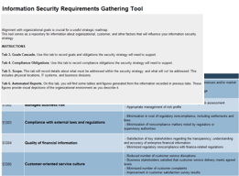
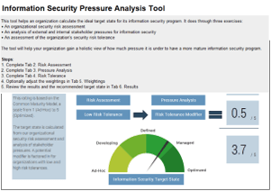
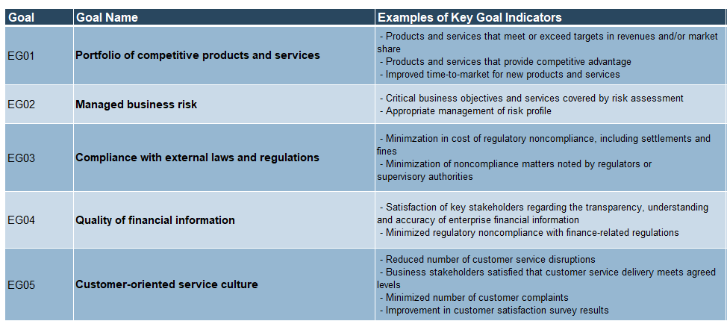

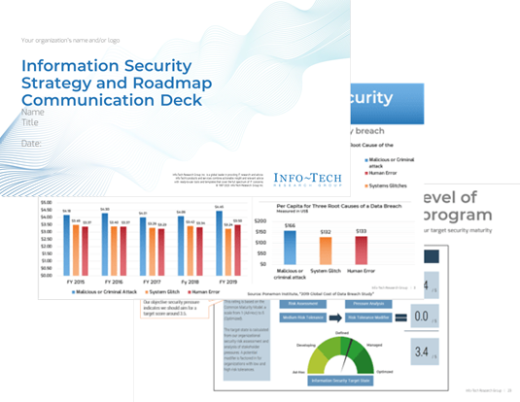
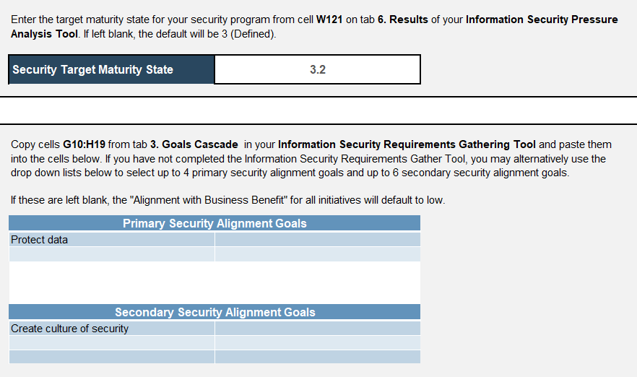
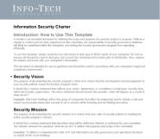
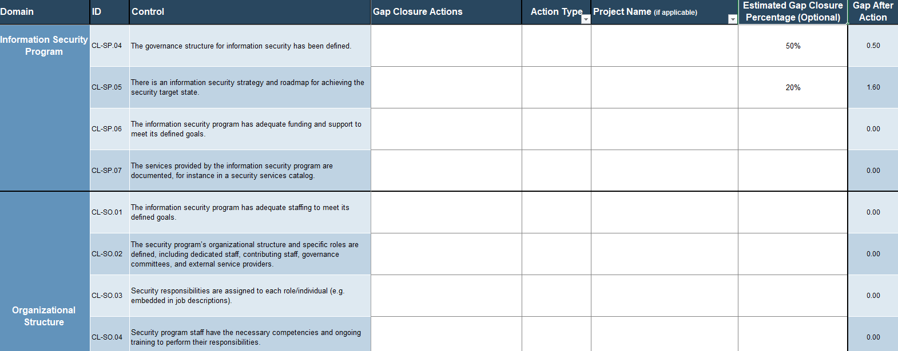
Blueprint deliverables
Key deliverable:
Each step of this blueprint is accompanied by supporting deliverables to help you accomplish your goals:
  Information Security Strategy Communication Deck
  Information Security Requirements Gathering Tool
  Information Security Pressure Analysis Tool
Present your findings in a prepopulated document that can summarizes all key findings of the blueprint.
Define the business, customer, and compliance alignment for your security program.
Determine your organization’s security pressures and ability to tolerate risk.
  Information Security Program Gap Analysis Tool
  Information Security Charter
Ensure the development and management of your security policies meet the broader program vision.
Use our best-of-breed security framework to perform a gap analysis between your current and target states.

Slide 16

Guided Implementation
A Guided Implementation is series of calls with an Info-Tech analyst to help implement our best practices in your organization.
A typical Guided Implementation is between 2-12 calls over the course of 4 to 6 months.
What does a typical Guided Implementation on this topic look like?
Assess Security Requirements
Execute and Maintain
Build a Gap Initiative Strategy
Prioritize Initiatives and Roadmap
Call #1: Introduce project and complete pressure analysis.
Call #2: Introduce the maturity assessment.
Call #4: Consolidate related gap initiatives and define, cost, effort, alignment, and security benefits.
Call #6: Build implementation waves and introduce Gantt chart.
Call #7: Review Gantt chart and ensure budget/buy-in support.
Call #3: Perform gap analysis and translate into initiatives.
Call #8: Three-month check-in: Execute and maintain.
Call #5: Review cost/benefit analysis and build an effort map.
Info-Tech Research Group | 16

Slide 17
Workshop Overview
Contact your account representative for more information.
workshops@infotech.com 1-888-670-8889
 | Day 1 | Day 2 | Day 3 | Day 4 | Day 5
Activities | Assess Security Requirements | Perform a Gap Analysis | Complete the Gap Analysis | Develop Roadmap | Communicate and Implement
 | 1.1 Understand business and IT strategy and plans 1.2 Define business and compliance requirements 1.3 Establish the security program scope 1.4 Analyze the organization’s risks and stakeholder pressures 1.5 Identify the organizational risk tolerance level | 2.1 Define the information security target state 2.2 Assess current security capabilities 2.3 Identify security gaps 2.4 Build initiatives to bridge the gaps | 3.1 Continue assessing current security capabilities 3.2 Identify security gaps 3.3 Build initiatives to bridge the maturity gaps 3.4 Identify initiative list and task list 3.5 Define criteria to be used to prioritize initiatives | 4.1 Conduct cost/benefit analysis on initiatives 4.2 Prioritize gap initiatives based on cost, time, and alignment with the business 4.3 Build effort map 4.4 Determine start times and accountability 4.5 Finalize security roadmap and action plan 4.6 Create communication plan | 5.1 Finalize deliverables 5.2 Support communication efforts 5.3 Identify resources in support of priority initiatives
Deliverables | Security obligations statement Security scope and boundaries statement Defined risk tolerance level Risk assessment and pressure analysis | Information security target state Security current state assessment Initiatives to address gaps | Completed security current state assessment Task list to address gaps Initiative list to address gaps Prioritization criteria | Information security roadmap Draft communication deck | Security strategy roadmap documentation Detailed cost and effort estimates Mapping of Info-Tech resources against individual initiatives

Slide 18


Executive Brief Case Study
INDUSTRY:
SOURCE:
Financial Services
Info-Tech Research Group
Credit Service Company
Founded over 100 years ago, Credit Service Company (CSC)* operates in the United States with over 40 branches located across four states. The organization services over 50,000 clients.
Situation
Increased regulations, changes in technology, and a growing number of public security incidents had caught the attention of the organization’s leadership. Despite awareness, an IT and security strategy had not been previously created. Management was determined to create a direction for the security team that aligned with their core mission of providing exceptional service and expertise.
Solution
During the workshop, the IT team and Info-Tech analysts worked together to understand the organization’s ideal state in various areas of information security. Having a concise understanding of requirements was a stepping stone to beginning to develop CSC’s prioritized strategy.
Results
Over the course of the week, the team created a document that concisely prioritized upcoming projects and associated costs and benefits. On the final day of the workshop, the team effectively presented the value of the newly developed security strategy to senior management and received buy-in for the upcoming project.
*Some details have been changed for client privacy

